Slide 1


Green Pace
Security Policy Presentation
Developer: Francis Ugorji
A summary of Green Pace’s Secure Development Policy

Slide 2

OVERVIEW: DEFENSE IN DEPTH
This Security policy is was developed to set the company in the right direction in terms of adherence to best practices and standards when handling our software and data. The layers of security here make up the Defense in depth strategy.

Slide 3
THREATS MATRIX
Summary:
Low Priority: Unlikely to happen with a low severity
Likely: Probable or likely to happen with a low severity
Priority: Probable or likely to happen with a high severity
Unlikely: Unlikely to happen but with a high severity
Likely STD-007-CPP STD-008-CPP STD-009-CPP STD-010-CPP | Priority STD-003-CPP STD-004-CPP STD-005-CPP
Low priority STD-002-CPP STD-006-CPP | Unlikely STD-001-CPP

Slide 4
10 PRINCIPLES
[List the 10 principles. List the coding standards that apply to each principle. This should demonstrate the alignment between principles and standards.]
1 Validate Input Data 2 Heed Compiler Warnings 3 Architect and Design for Security Policies 4 Keep It Simple 5 Default Deny 6 Adhere to the Principle of Least Privilege 7 Sanitize Data Sent to Other Systems 8 Practice Defense in Depth STD-004-CPP STD-001-CPP, STD-002-CPP STD-006-CPP, STD-007-CPP, STD-008-CPP STD-009-CPP STD-002-CPP, STD-004-CPP, STD-008-CPP, STD-010-CPP STD-009-CPP STD-005-CPP 9 Use Effective Quality Assurance Techniques STD-003-CPP, STD-005-CPP, STD-007-CPP 10 Adopt a Secure Coding Standard STD-003-CPP, STD-008-CPP, STD-010-CP
1 | Validate Input Data | STD-004-CPP, STD-001-CPP
2 | Heed Compiler Warnings | STD-001-CPP, STD-002-CPP
3 | Architect and Design for Security Policies | STD-006-CPP, STD-007-CPP, STD-008-CPP
4 | Keep It Simple | STD-002-CPP, STD-004-CPP, STD-008-CPP, STD-010-CPP
5 | Default Deny | STD-009-CPP
6 | Adhere to the Principle of Least Privilege | STD-009-CPP
7 | Sanitize Data Sent to Other Systems | STD-004-CPP
8 | Practice Defense in Depth | STD-005-CPP
9 | Use Effective Quality Assurance Techniques | STD-003-CPP, STD-005-CPP, STD-007-CPP
10 | Adopt a Secure Coding Standard | STD-003-CPP, STD-008-CPP, STD-010-CPP

Slide 5
CODING STANDARDS
[List the 10 coding standards. Explain your own ranking system for vulnerabilities, using specific details from the coding standards in your security policy.]
STD-004-CPP | Sanitize data passed to complex subsystems
STD-005-CPP | deallocate dynamically allocated resources properly
STD-003-CPP | Range check element access
STD-008-CPP | Value returning function must return a value from all exit paths
STD-002-CPP | Do not modify constant objects
STD-007-CPP | Handle as much exceptions as possible to avoid premature termination
STD-001-CPP | Ensure all input is accurate and secure to prevent harmful data from entering the system minimizing security risks. system, minimizing security risks
STD-006-CPP | Use static assertions to confirm desired results
STD-009-CPP | Ensure proper closure of all file streams when done
STD-010-CPP | User-provided copy operators must properly handle self-copy assignment.

Slide 6
ENCRYPTION POLICIES
Encryption in rest | Encryption at rest refers to the process of keeping data in an encrypted state while it is stored. This means that even if someone manages to gain access to the data, it remains unreadable without the key required to decrypt it. Implementing this policy is crucial, as it ensures that if a breach occurs and data is stolen, the information contained within remains secure and cannot be interpreted without the decryption key. This type of encryption is particularly suitable for backup data that is stored away for extended periods.
Encryption at flight | Encryption in transit refers to the practice of keeping data encrypted while it travels from one location to another. During its journey, it is essential for the data to remain encrypted. This approach that if the data is intercepted, the information contained within remains secure, as it cannot be read without the appropriate key. Such encryption is commonly implemented in various internet protocols, including HTTPS, FTP, and SMTP.
Encryption in use | Encryption in use refers to the practice of encrypting data while it is being actively utilized by the system. This approach is essential for maintaining data security at all times, even as it undergoes changes. As more data is secured through encryption at rest and in transit, the possibility of exploitation increases for data that remains unencrypted during use, making it the weakest link. Therefore, it is crucial to find solutions that allow for data to remain encrypted while being utilized. This methodology is commonly implemented in applications, where certain components may be encrypted to ensure that users do not gain access to sensitive information.

Slide 7
TRIPLE-A POLICIES
Authentication | Authentication is the process of verifying a user's identity to ensure that they are who they claim to be. This procedure is commonly employed when adding new users or when a user attempts to log in. This policy is applicable whenever a user seeks access to a system or any specific element within it. It is essential to confirm that the individual accessing the system is indeed the expected user. This verification is typically achieved by validating user identification information, such as a username and password.
Authorization | Authorization is the process of verifying that a user is entitled to access the resources they are requesting. It establishes the user level of access that a user has within the system. This policy is applicable whenever a user attempts to access a system or any of its components. Once a user has been authenticated, authorization determines whether they are granted entry to the system or specific items within it. This policy is also responsible for making sure that the right user or administrator is the right person authorized to set and modify authorization features for users, when it comes to changing user privileges or when it comes to the addition of new users. This mechanism helps prevent unauthorized users from accessing restricted areas, ensuring that only individuals with the appropriate permissions can enter.
Accounting | Accounting is the process of monitoring and recording all requests and transactions made by a user. Examples include changes made to a database or files accessed by a user. This policy is essential for maintaining awareness of system activities. For instance, if the system begins to behave unexpectedly, you can review the logs to identify the issue and work towards finding a solution.

Slide 8
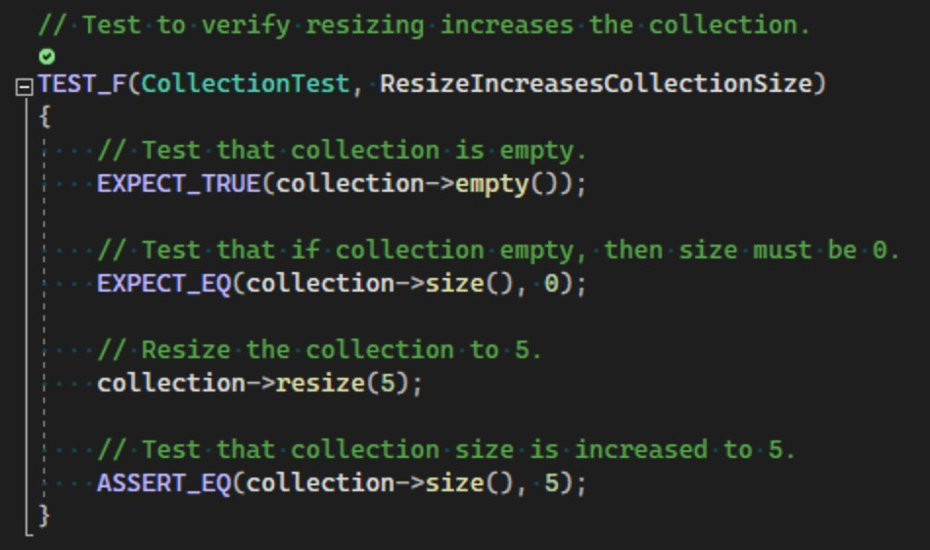
Unit Testing
ResizeIncreaseCollectionSize -

Slide 9
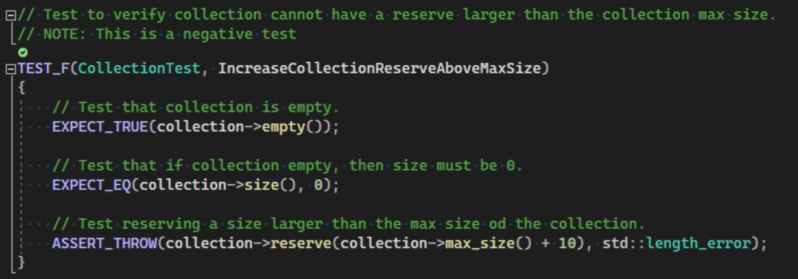
Unit Testing
IncreaseCollectionReserveAboveMaxSize -

Slide 10
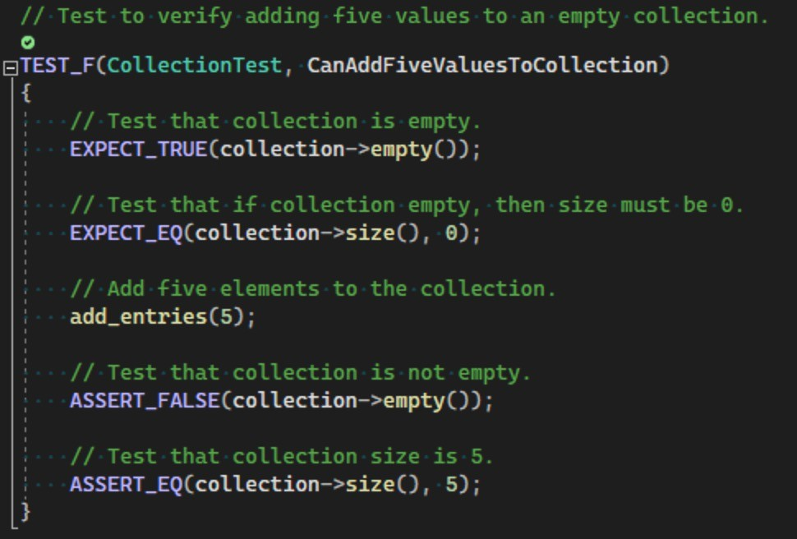
Unit Testing
CanAddFiveValuesToCollection -

Slide 11
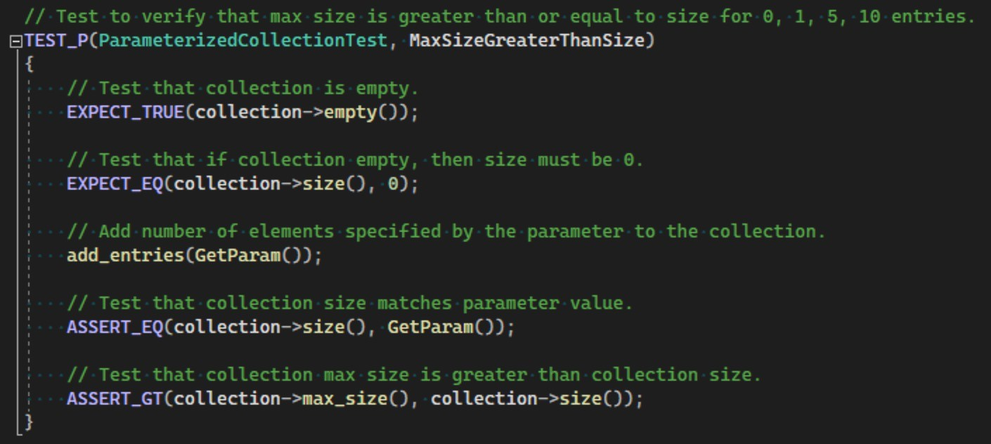
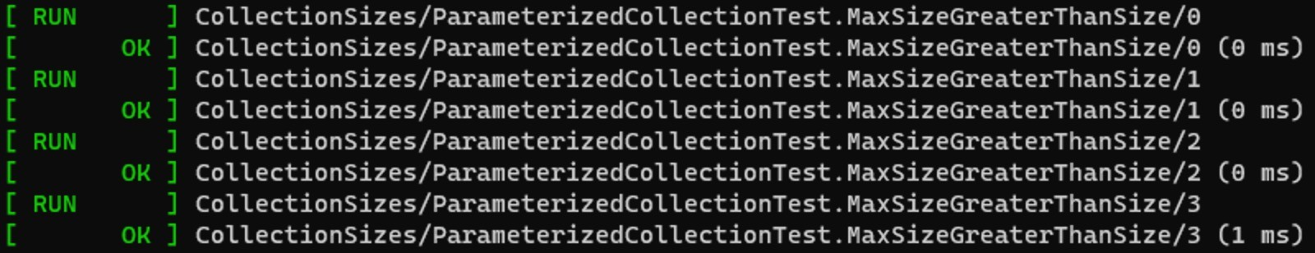
Unit Testing
MaxSizeGreaterThanSize -

Slide 12
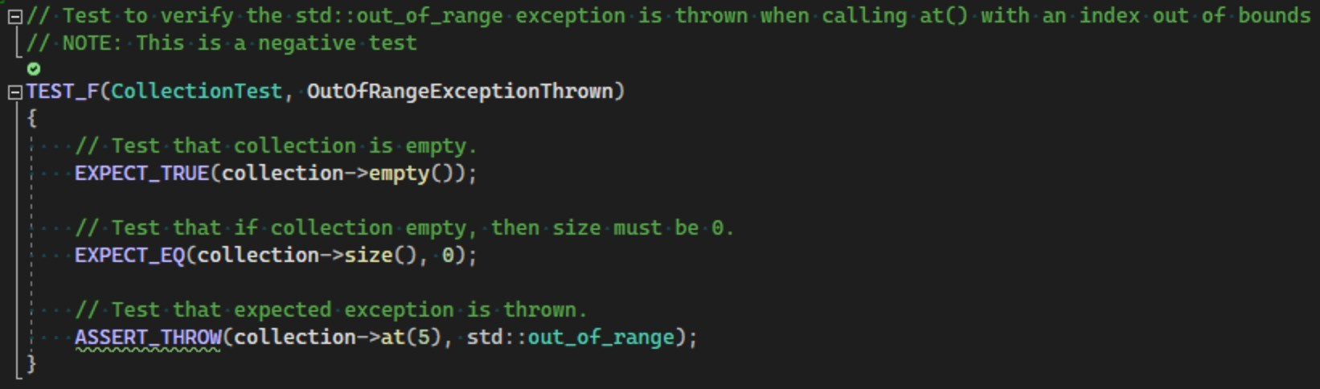
Unit Testing
OutofRangeExceptionThrown -

Slide 13
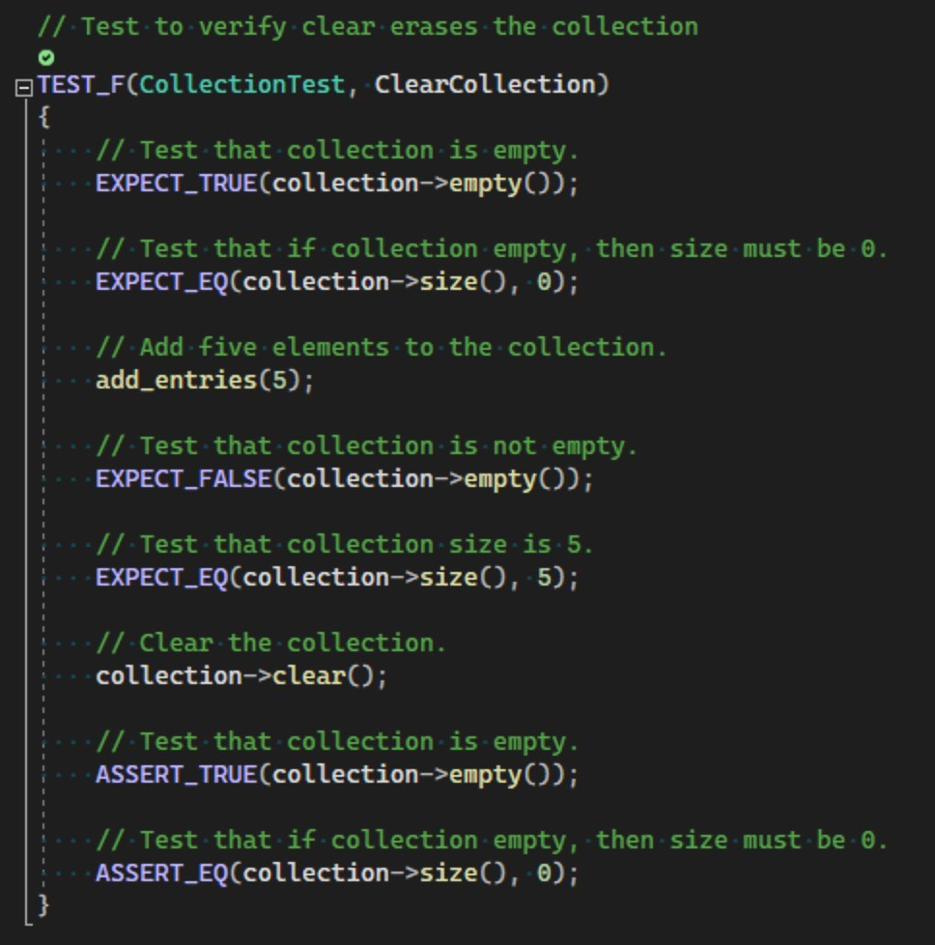
Unit Testing
ClearCollection -

Slide 14

AUTOMATION SUMMARY
DevSecOps plays a vital role in developing secure applications, ensuring that security is integrated seamlessly throughout the software development lifecycle.
By leveraging automation, organizations can significantly enhance this process. It is essential to adhere to the policies and standards outlined in the security policy document during the DevSecOps workflow.

Slide 15
TOOLS
The DevSecOps pipeline outlines the comprehensive flow of the software development process, integrating development, security, and operations throughout various stages.
Stages:
Pre-production: In this stage, the software development process is planned, which leads to the software being designed by system engineers, built by software engineers (Front and Backend), Tested for quality and correctness by quality engineers
Production(ready for market): This consist of deploying, monitoring, maintaining and tracking for problems, and the cycle continues

Slide 16
RISKS AND BENEFITS
When should you act on the security needs of your Application, infrastructures?
Now? When Threat is detected? After Infiltration?
Its appropriate to act Now. Security should be part of the planning stage of the software development and deployment process
Security Should meet required standards and proper protocols should be implemented right at the begining
Benefits of acting Now: Its easier to implement at the beginning than later; Its easier to prevent and deter than to fix. Code will be more consistent

Slide 17
RISKS AND BENEFITS
Risks of Acting Now
it might slow down development process (deadlines might become hard to reach)
Adding security might require additional skilled staff
Additional training of developers might be needed
Risks of Acting later
Application breached and data exposed if taking a wait and see approach
It might become too costly or even impossible to reverse harm done if infiltrated before implementing security measures
Planning and implementation will require additional steps, costing time and money

Slide 18
RECOMMENDATIONS
Security policy needs to be strictly adhered to and followed as written
Training needs to be provided to developers
All the software development life cycles needs to be in place and nothing should be left out when it comes to implementing security

Slide 19
CONCLUSIONS
Having a security inclusion is a necessity for the software development process to be deemed complete and standardized.
A security policy and code standards should be implement at the onset
Enforcement of the policy and standard should be made a priority
Training of developers on policy and security needs should be part of the development process
Training must be provided on security and the security policy
Security policies should be reviewed and revised often to meet current security trends

Slide 20
REFERENCES
[SEI CERT C++ Coding Standard - SEI CERT C++ Coding Standard - Confluence. (n.d.). https://wiki.sei.cmu.edu/confluence/pages/viewpage. action?pageId=88046682
Secure Software Development Guide - https://ldra.com/sei-cert/
Microsoft. (2022, October 11). Best practices for a secure software supply chain. Microsoft Learn. https://learn.microsoft.com/en- us/nuget/concepts/security-best-practices

